Slide 1
Substitution – Perimeter, Area, and Cost Functions
Miss Lum
Year 10 Maths

Slide 2
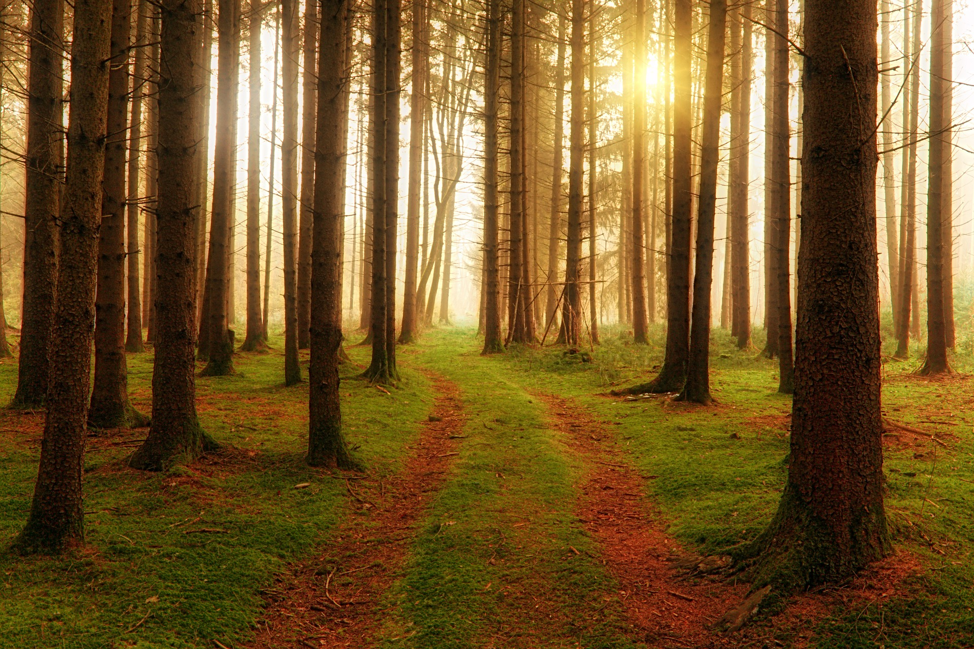
Learning Outcomes
Substitute values into formulas to determine an unknown (ACMNA234)

Slide 3




24
7
30
Substitution of Values into Formulas
Date: /03/2018
EQ – How do we solve for an unknown in a formula?
To evaluate an algebraic expression you use substitution. You put in values for the variables, (substitute values) and work out the answer.
When x = - 3 is substituted into the expression 5x + 8, its value is 7.
$$5x+8$$
$$=5×−3+8$$
$$=−15+8$$
$$=−7$$

Slide 4

24
7
30
Substitution of Values into Formulas
Date: /03/2018
EQ – How do we solve for an unknown in a formula?
To evaluate an algebraic expression you use substitution. You put in values for the variables, (substitute values) and work out the answer.
When x = -3 is substituted into the expression 5x + 8, its value is 7.
$$5x+8$$
$$=5×−3+8$$
Remember: Order of Operations applies!
$$=−15+8$$
$$=−7$$

Slide 5









Perimeter and ARea
The perimeter, (P) and area, (A) of a rectangle can be calculated using these formulae:
$$l$$
$$P=2(l+w)$$
$$w$$
$$w$$
$$A=l×w$$
$$l$$
Calculate the perimeter and area of rectangular gardens with these measurements.
Length $l=5$m
Width $w=4$ m
Length $l=10$m
Width $w=8$ m
Length $l=8$m
Width $w=8$ m
Notes:
Guided Practice

Slide 6

Check our understanding

Slide 7



Perimeter and ARea
The perimeter, (P) and area, (A) of a rectangle can be calculated using these formulae:
$$l$$
$$P=2(l+w)$$
$$w$$
$$w$$
$$A=l×w$$
$$l$$
Calculate the perimeter and area of rectangular gardens with these measurements.
Length $l=11$m
Width $w=6$ m
Length $l=9$m
Width $w=7$ m
Length $l=12$m
Width $w=5$ m
Notes:
Students to complete without teacher assistance

Slide 8
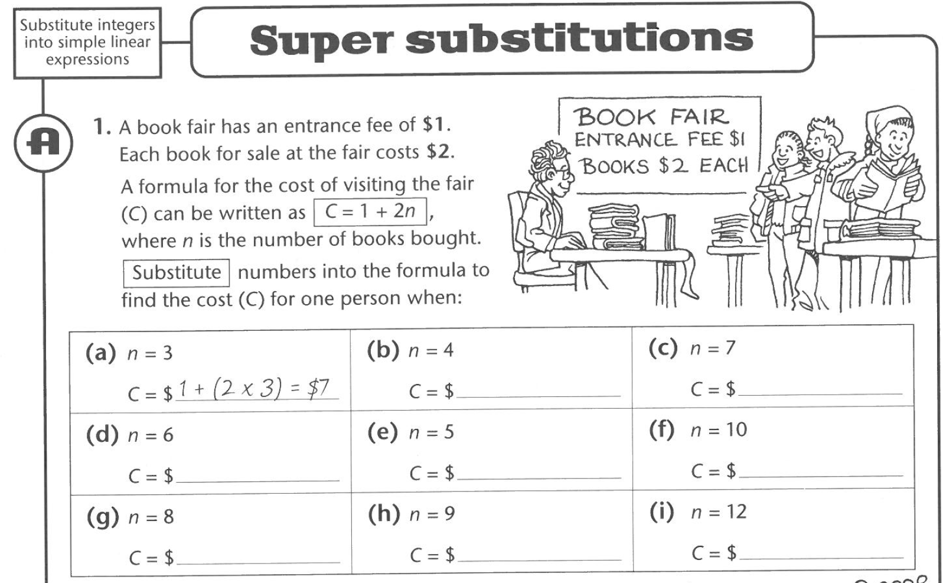
Simple Linear Equations

Slide 9
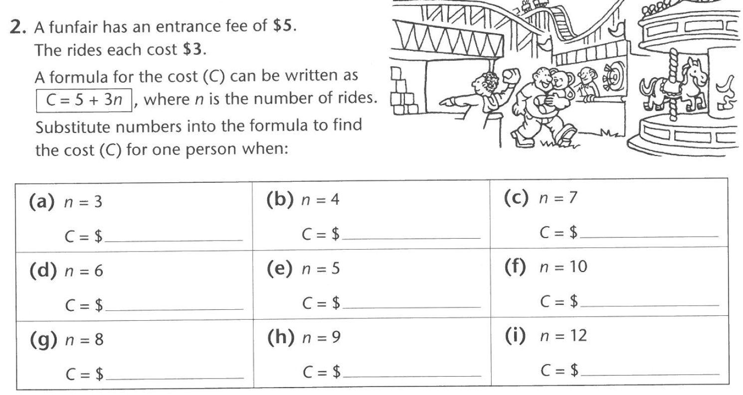
Simple Linear Equations

Slide 10
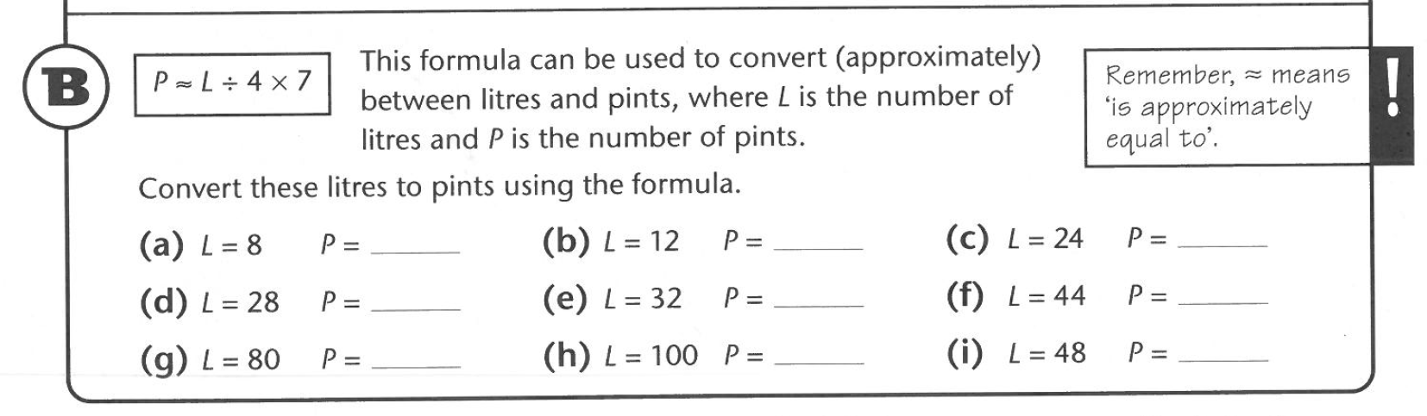
Simple Linear Equations

Slide 11
HomeWORK
Complete your summaries
Write your questions
24, 7, 30

